Slide 1
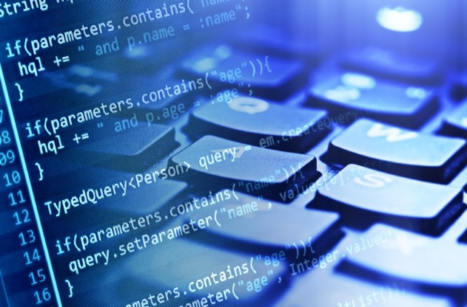
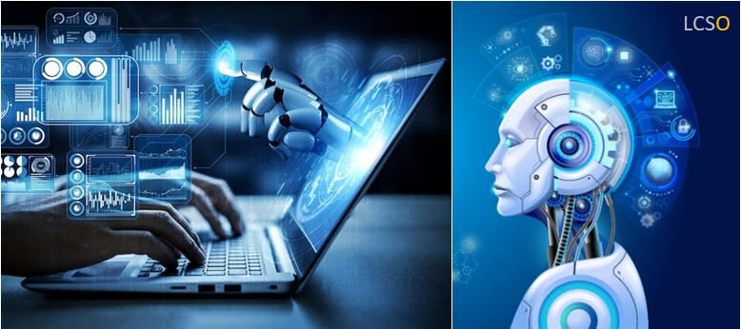
Build Simpe AI Model using Python
LÊ TRỌNG NHÂN
trongnhanle@hcmut.edu.vn
trongnhanle85@gmail.com

Slide 2
Content
Create repository in GitHub
Build a simple AI model in Google Teachable Machine
Implement AI inference using Python
Extend the system to mobility camera using your phone
Commit your source code to Github
Submit your Github to Google Sheet

Slide 3
Part 1: Create Repository on GitHub

Slide 4
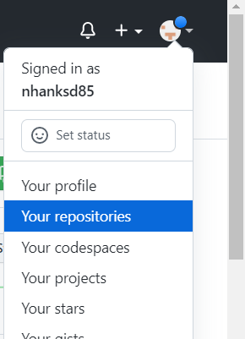
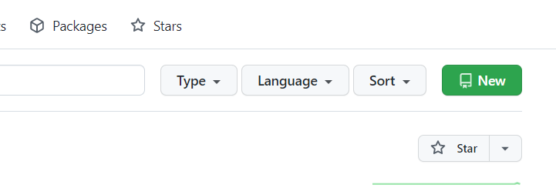
Step 1
Login to your account
Select Your repositories
Select New
Name your Project (VGU_AIoT)
Click on Create Repository
Copy the link on the web browser

Slide 5
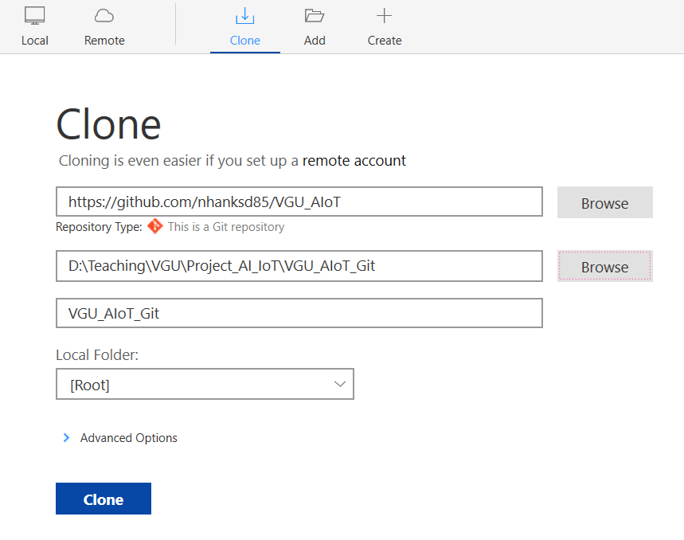
Step 2
Clone the project to a folder in your PC:
Create an Empty Folder, named VGU_AIoT_Git
Click on Clone

Slide 6
Part 2: Build A Simple AI

Slide 7
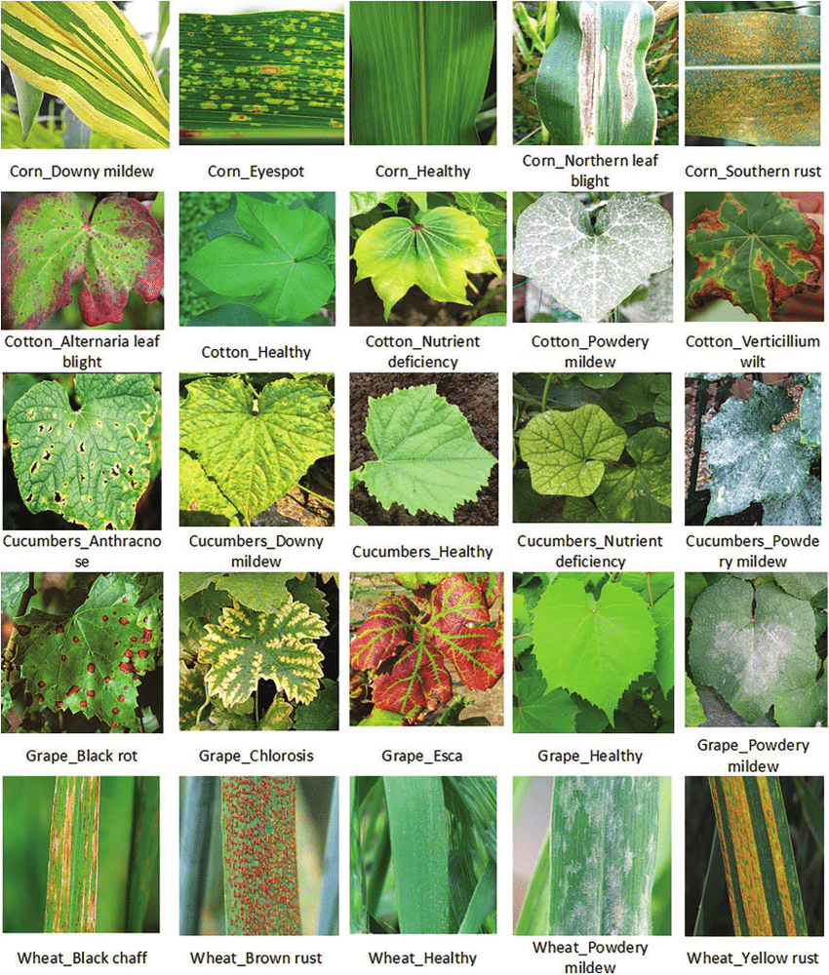
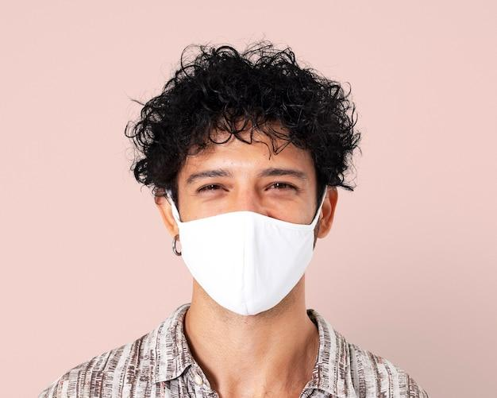
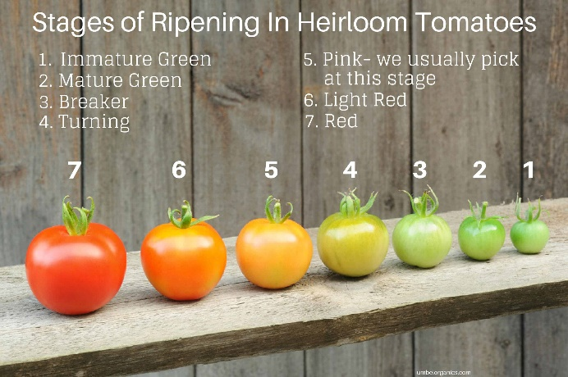
Build a simple AI model
Use PC webcam to recognize simple objects, for instance:
People is wearing masks or not wearing masks
Ripe tomatoes (normally in red) or raw tomatoes (normally in green)
Leaves are wilted or diseased

Slide 8
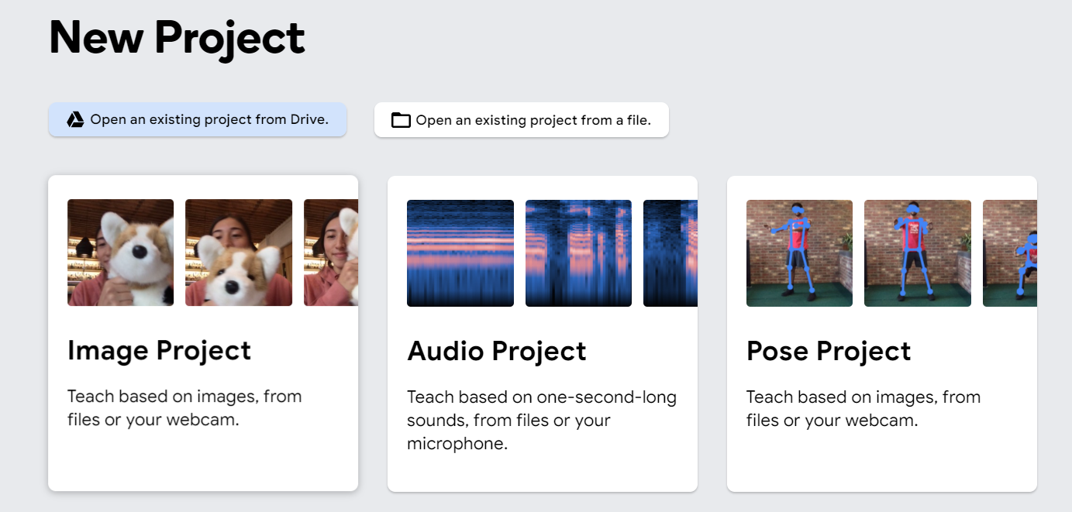

Step 1
Go to the Google Teachable Machine website:
https://teachablemachine.withgoogle.com/train
Select on the Image Project
1

Slide 9
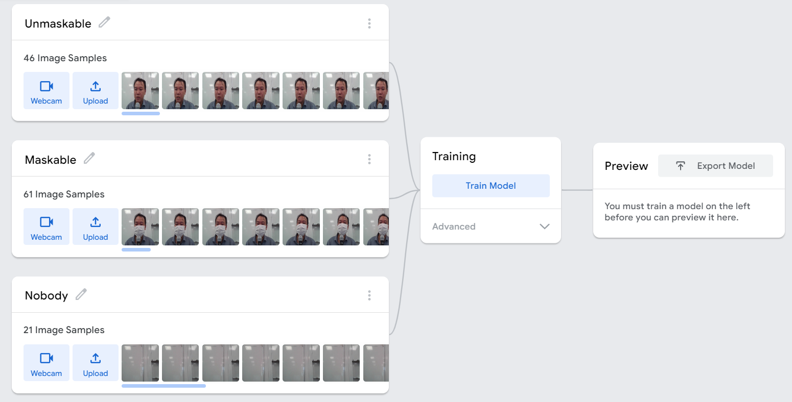
Step 2
Provide images for each class. Note that each class should have a name.
Provide a class name “background”, when there is no object need to be recognized

Slide 10
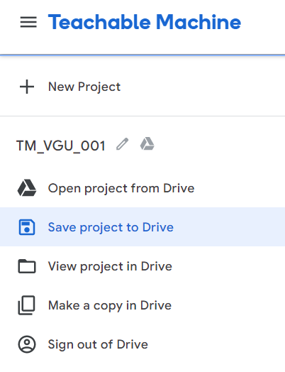
Step 3
Save your project to Google Drive
1
2

Slide 11
Step 4
Click on the Train Model button to train your AI
Test your model in the Preview option. If the performance is not so good, provide more images and train the AI again
1

Slide 12
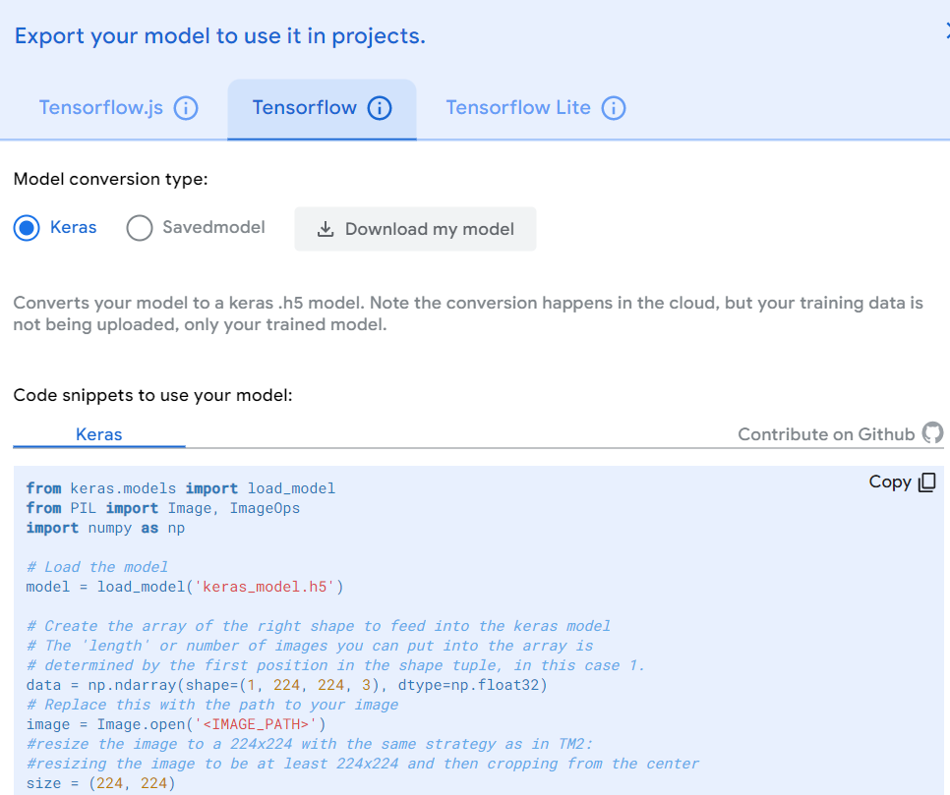
Step 4
Export the AI model:
Click on Export
Select Tensorflow, Keras and Download the Model
1
2
3

Slide 13
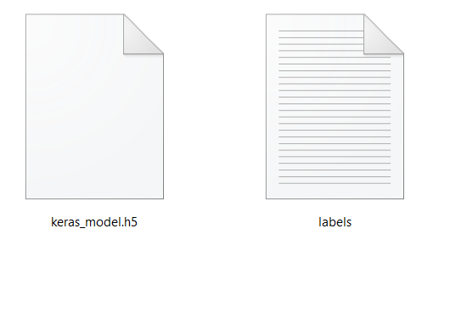
Step 5
Prepare materials for Python programming:
Unzip the files
Copy the source code from Google Teachable to Notepad
Python Source Code
AI Files (keras_model.h5 and lables.txt)
from keras.models import load_model
from PIL import Image, ImageOps
import numpy as np
# Load the model
model = load_model('keras_model.h5')
# Create the array of the right shape to feed into the keras model
# The 'length' or number of images you can put into the array is
# determined by the first position in the shape tuple, in this case 1.
data = np.ndarray(shape=(1, 224, 224, 3), dtype=np.float32)
# Replace this with the path to your image
image = Image.open('<IMAGE_PATH>')
#resize the image to a 224x224 with the same strategy as in TM2:
#resizing the image to be at least 224x224 and then cropping from the center
size = (224, 224)
image = ImageOps.fit(image, size, Image.ANTIALIAS)
#turn the image into a numpy array
image_array = np.asarray(image)
# Normalize the image
normalized_image_array = (image_array.astype(np.float32) / 127.0) - 1
# Load the image into the array
data[0] = normalized_image_array
# run the inference
prediction = model.predict(data)
print(prediction)

Slide 14
Part 3: Python Programming

Slide 15
Step 2
Install following libraries (required for AI processing):
tensorflow
keras
numpy
Pillow
opencv-python
In Pycharm Editor, these libraries can be installed through GUI:
From menu File, select Setting
Navigate to the Project
Select Python Interpreter
Click on Add icon, filter the library and click on Install

Slide 16
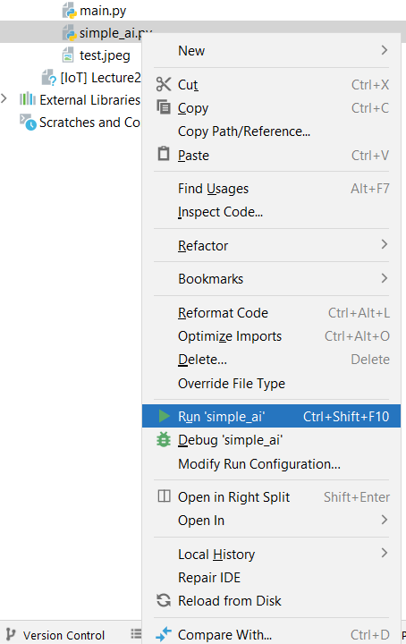
Step 1
Create a new python file in the project (e.g. simple_ai.py)
Run this file:
Right click on the file
Select Run

Slide 17
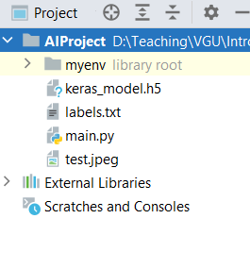
Step 4
Copy the AI Files (keras_model.h5 and lables.txt) to the same folder of main.py
Copy an simple image to the same folder of main.py (the resolution should be higher than 224x224 pixel)
1

Slide 18
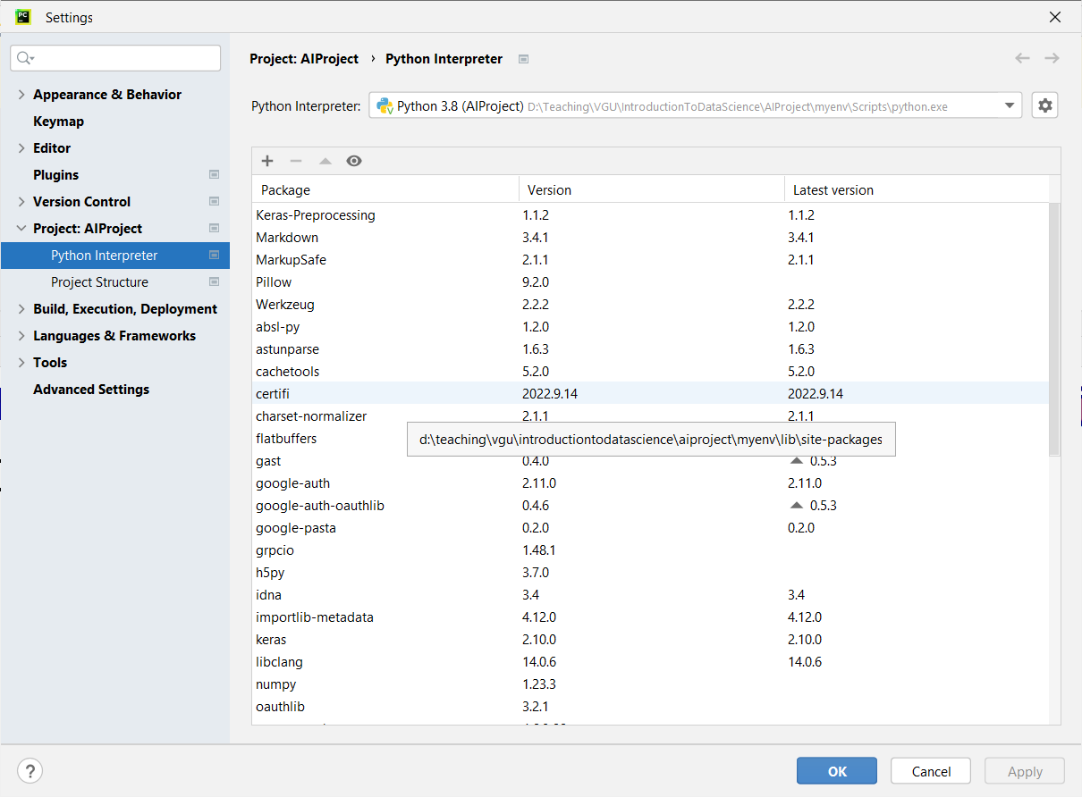
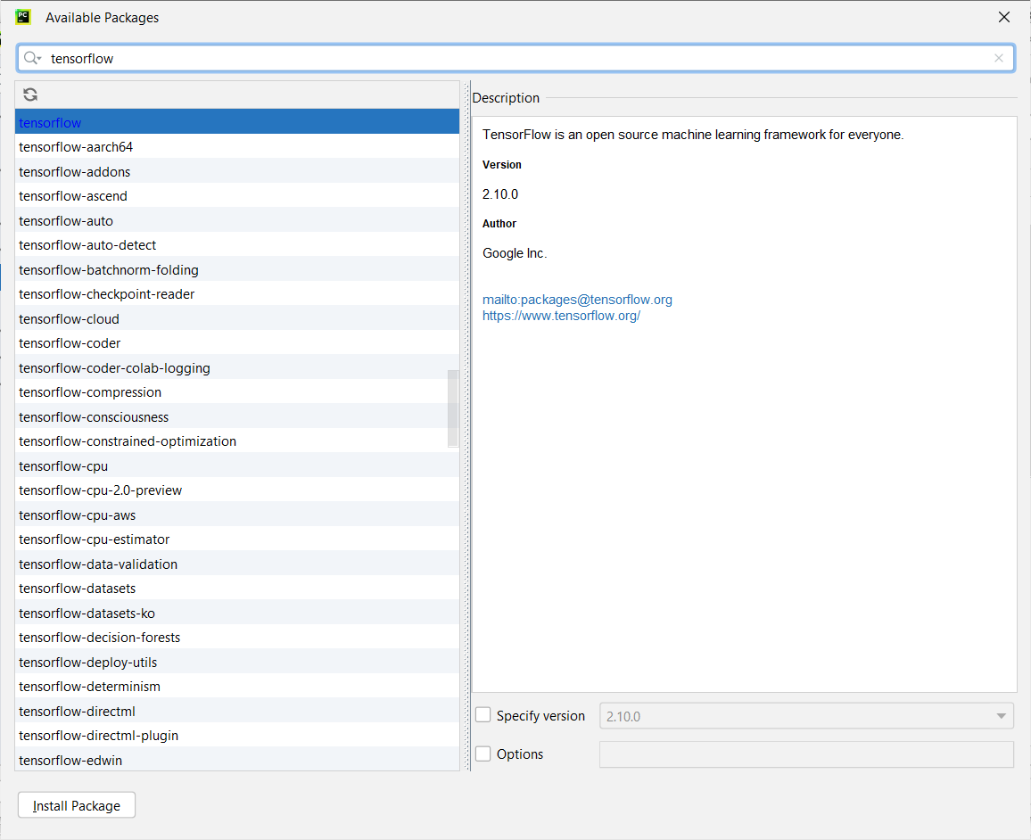
Install library by GUI in PyCharm
3
2
1
4
This option is only available in Pycharm IDE. Other IDEs normally use the pip command to install a package

Slide 19
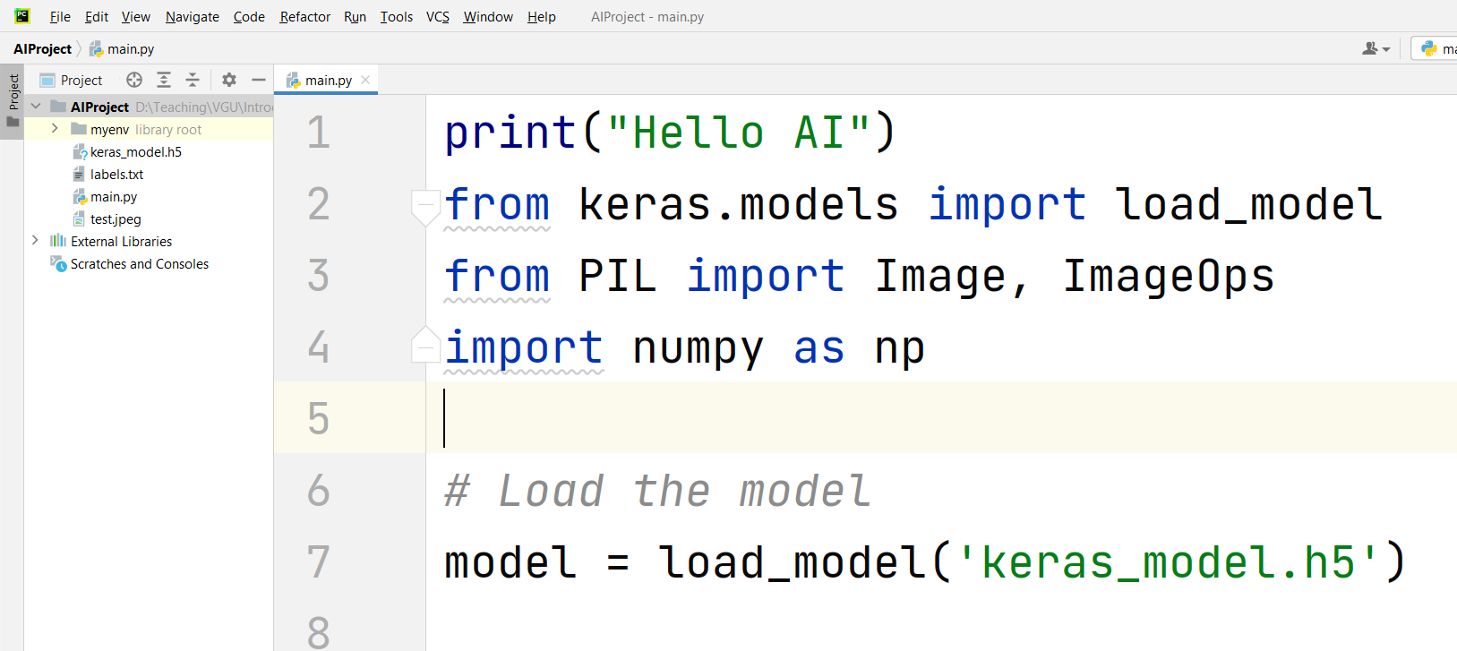
Step 5
Copy the whole source code and place in main.py:

Slide 20
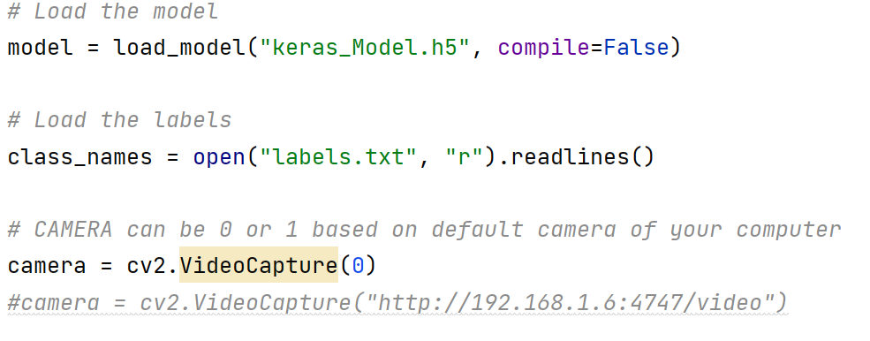
Step 6
Initiate your webcam or camera:

Slide 21
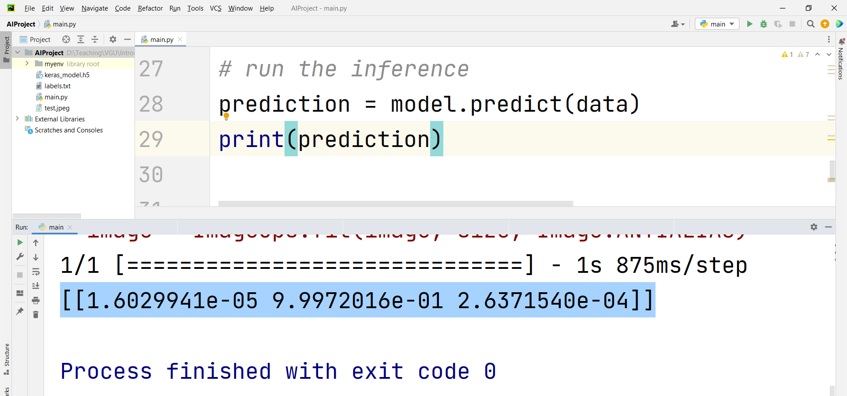
Step 7
Run the python program. The output should be an 2D array, presenting the confidence (in percent) of all the labels trained in Google Teachable Machine

Slide 22
Step 8
import time from keras.models import load_model # TensorFlow is required for Keras to work import cv2 # Install opencv-python import numpy as np # Disable scientific notation for clarity np.set_printoptions(suppress=True) # Load the model model = load_model("keras_Model.h5", compile=False) # Load the labels class_names = open("labels.txt", "r").readlines() # CAMERA can be 0 or 1 based on default camera of your computer camera = cv2.VideoCapture(2) #camera = cv2.VideoCapture("http://192.168.1.6:4747/video") def image_detector(): # Grab the webcamera's image. ret, image = camera.read() # Resize the raw image into (224-height,224-width) pixels image = cv2.resize(image, (224, 224), interpolation=cv2.INTER_AREA) # Show the image in a window cv2.imshow("Webcam Image", image) # Make the image a numpy array and reshape it to the models input shape. image = np.asarray(image, dtype=np.float32).reshape(1, 224, 224, 3) # Normalize the image array image = (image / 127.5) - 1 # Predicts the model prediction = model.predict(image) index = np.argmax(prediction) class_name = class_names[index] confidence_score = prediction[0][index] # Print prediction and confidence score print("Class:", class_name[2:], end="") print("Confidence Score:", str(np.round(confidence_score * 100))[:-2], "%") while True: image_detector() time.sleep(5)
Refactor the python source code with image_detector() function

